Slide 1
Pick N Place Robot

Slide 2
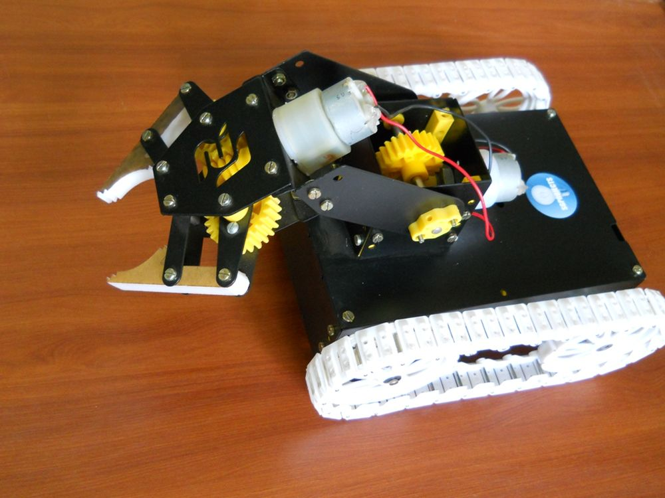
Introduction:
Pick and Place robot is the one which is used to pick up an object and place it in the desired location. It can be a cylindrical robot providing movement in horizontal, vertical and rotational axes, a spherical robot providing two rotational and one linear movement, an articulate robot or a scara robot (fixed robots with 3 vertical axes rotary arms).

Slide 3
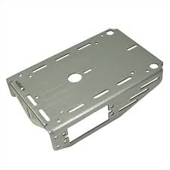
Pick N Place Robot
Parts of a Pick N Place Robot
Chasis- A chassis consists of an internal vehicle frame that supports an artificial object in its construction and use, can also provide protection for some internal parts

Slide 4
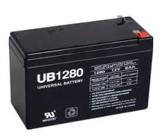
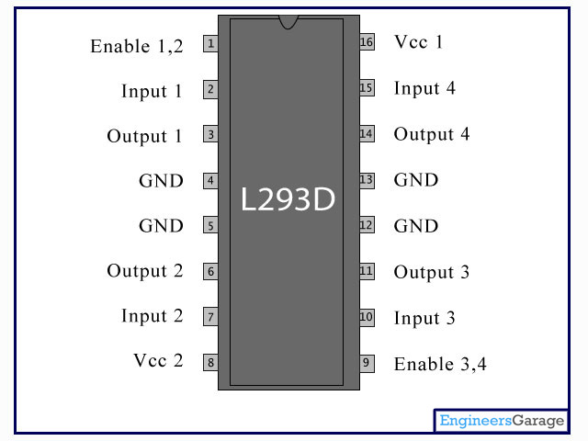
Pick N Place Robot
12 V Battery:
L293D: L293D is a dual H-bridge motor driver integrated circuit (IC). Motor drivers act as current amplifiers since they take a low-current control signal and provide a higher-current signal. This higher current signal is used to drive the motors.

Slide 5
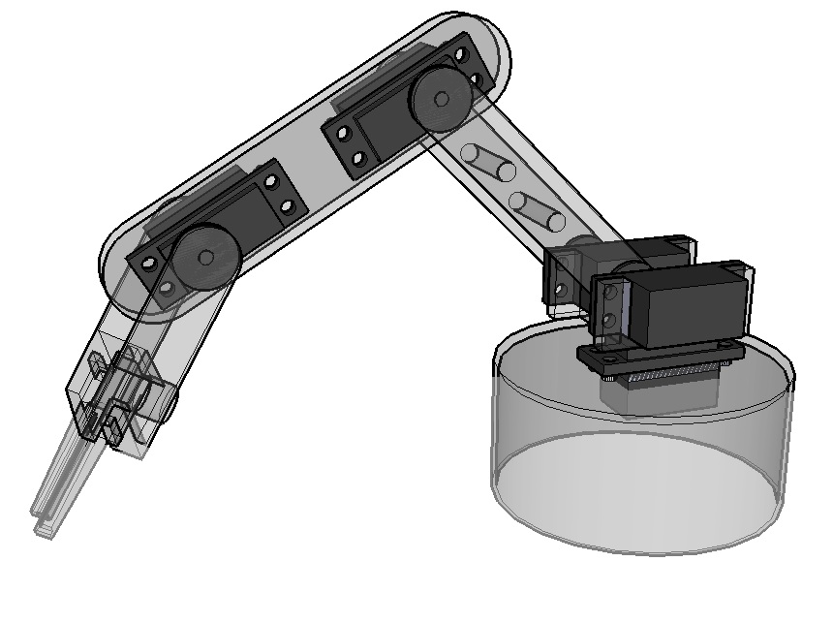
Pick N Place Robot
Robotic Arm- A robotic arm is a type of mechanical arm, usually programmable, with similar functions to a human arm. It includes 2 DC motors, 4 wheels with track belts and arm gripper

Slide 6
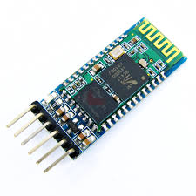
HC05 Bluetooth Module- HC-05 module is an easy to use Bluetooth) module, designed for transparent wireless serial connection setup.
Arduno Uno

Slide 7
WORKING
The transmitter part consists of the bluetooth module interfaced to the microcontroller.
Any button number in decimal format is converted to 4 digit binary by the microcontroller and the parallel output at one of its port is applied to the encoder.
The encoder converts this parallel data to serial data and this is fed to the transmitter, fitted with an antenna to transmit the serial data.

Slide 8
The basic function of a pick and place robot is done by its joints.
Joints are analogous to human joints and are used to join the two
consecutive rigid bodies in the robot.
They can be rotary joint or linear joint. To add a joint to any link of a robot, we need to know about the degrees of freedom and degrees of movement for that body part. Degrees of freedom implement the linear and rotational movement of the body and Degrees of movement imply the number of axis the body can move.

Slide 9
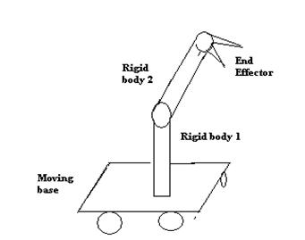

Slide 10
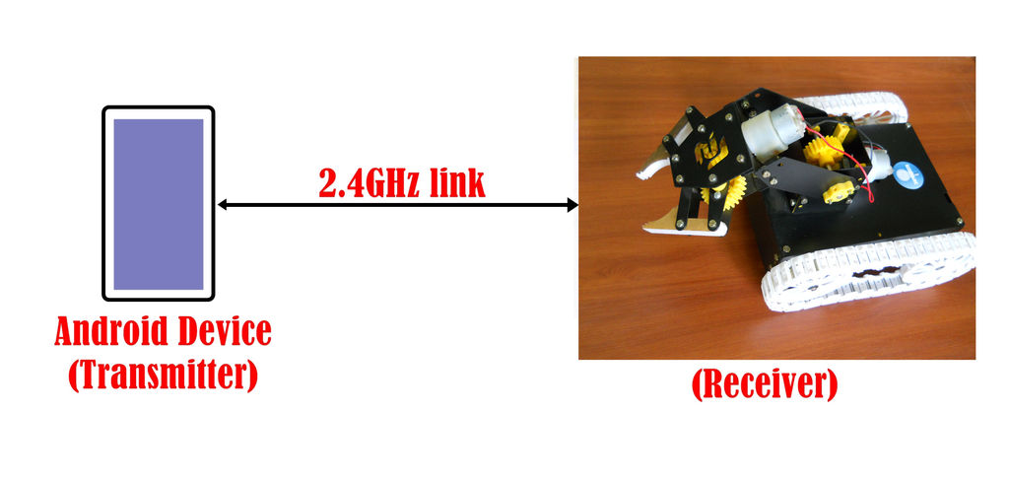

Slide 11
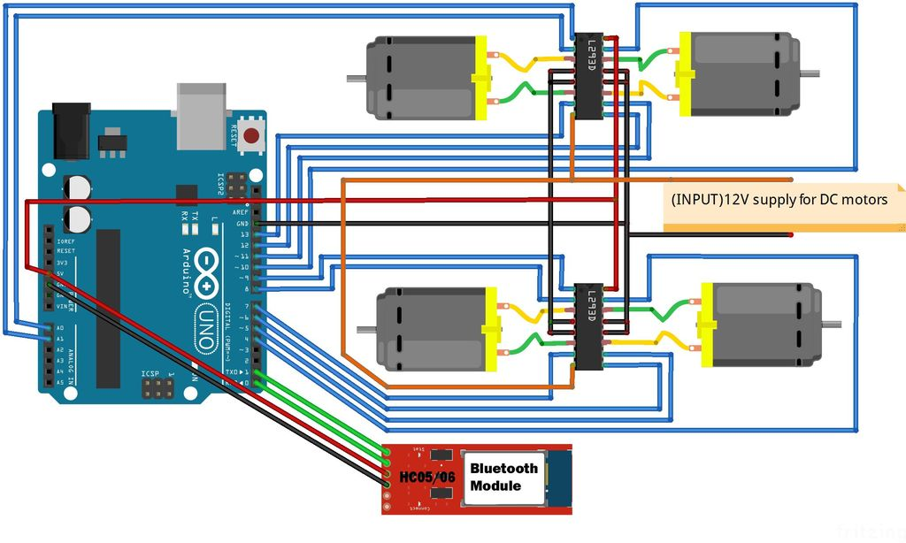

Slide 12
Pick N Place Robot
Advantages
They are faster and can get the work done in seconds compared to their human counterparts.
They are flexible and have the appropriate design.
They are accurate.
They increase the safety of the working environment and actually never get tired.

Slide 13
Pick N Place Robot
Disadvantages
1. Expense: The initial investment to integrated automated robotics into your business is significant. Regular maintenance needs can have a financial toll as well.
2. ROI: Incorporating industrial robots does not guarantee results. Without planning, companies can have difficulty achieving their goals.
3. Expertise: Employees will require training program and interact with the new robotic equipment. This normally takes time and financial output.
4. Safety: Robots may protect workers from some hazards, but in the meantime, their very presence can create other safety problems. These new dangers must be taken into consideration.

Slide 14
Pick N Place Robot
Practical Applications of Pick and Place Robot
Defense Applications: It can be used for surveillance and also to pick up harmful objects like bombs and diffuse them safely.
Industrial Applications: Pick and Place Robots are used in manufacturing, to pick up the required parts and place it in correct position to complete the machinery fixture. It can be also used to place objects on the conveyer belt as well as pick up defective products from the conveyer belt.
Medical Applications: These robots can be used in various surgical operations like in joint replacement operations, orthopaedic and internal surgery operations. It performs the operations with more precision and accuracy.

Slide 15


